Slide 1

Introduction to Computer Organization

Slide 2
Simple Computer Architecture
1.Datapath, which consists of:
A set of registers
The micro-operations performed on data stored in the registers
The control interface
2. Control Unit, which provides signals that control micro-operations performed in the Datapath and other components
In computer systems, a shared arithmetic/logic unit (ALU) is used to perform micro-operations
The contents of registers are transferred to the ALU, which performs the operation and then transfers them to the destination

Slide 3
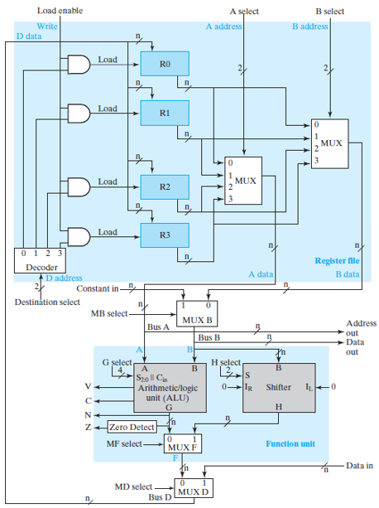
Datapath

Slide 4

Denotation of the registers
Registers are denoted by uppercase letters (followed by numbers)
The individual flip-flops in a n bit register are numbered from 0 to n-1 with 0 the LSB

Slide 5
Denotation of data transfer
Data transfer from one register to another is denoted using the ← operator
R2 ← R1
R1 is the source of transfer and R2 the destination
Conditional statements used when data transfer occurs only on receiving a control signal
K₁: R2 ← R1
K₁ can be any Boolean function or variable that evaluates to 0 or 1
K₃: R2 ← R1, R1← R2

Slide 6
Datapath
To perform R1 ← R2 + R3
The control unit must provide the following control inputs:
A select, to place contents of R2 onto A data and Bus A
B select to place contents of R3 onto 0 input of MUX B; and MB select to put 0 input of MUX B onto Bus B
G select, to complete A+B
MF select, to place the ALU
output on the MUX F output
MD select, to place the MUX F output onto Bus D
Destination select, to select R1 as the destination of the data on Bus D
Load enable, to enable R1 to be loaded

Slide 7
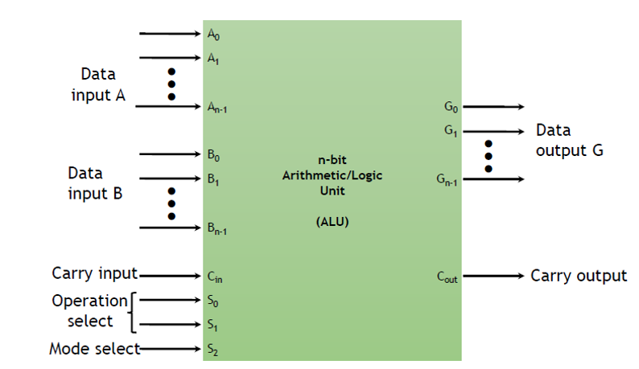
Arithmetic/Logic unit
An arithmetic/logic unit (ALU) is a combinational circuit that performs basic arithmetic and logic operations

Slide 8
Arithmetic/Logic unit
Performs a set of basic arithmetic and logic micro-operations
The n-bit result is output on vector G with carry-out on C_{out}
S₂ selects between arithmetic or logic operations S₁ and S₀ select one of 4 operations within the arithmetic or logic operations
Can be extended to 8 operations by using the C_{in}(carry-in) input

Slide 9
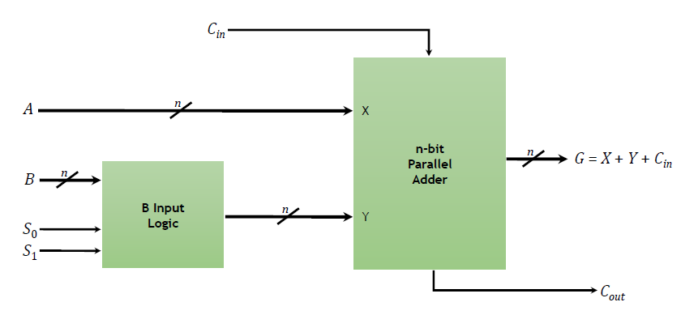
Arithmetic unit

Slide 10
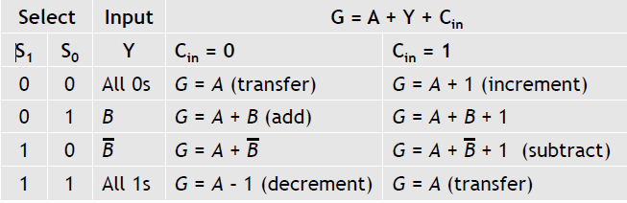
Arithmetic unit
The arithmetic circuit is based on the n-bit parallel adder
By controlling the inputs to the adder, different types of arithmetic operations can be obtained
Connect the X input of the adder directly to operand A Make the input Y some function of operand B

Slide 11
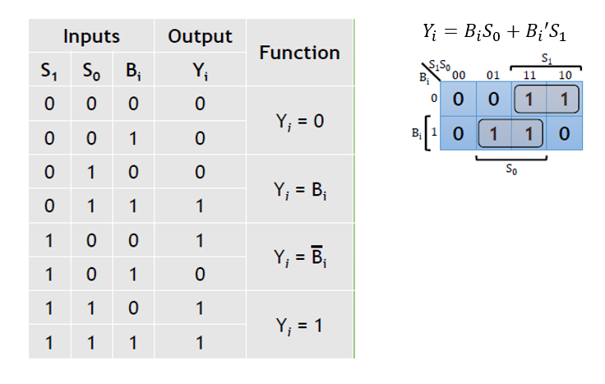
Arithmetic unit
Use a truth table and k-maps to implement the select logic on input B

Slide 12
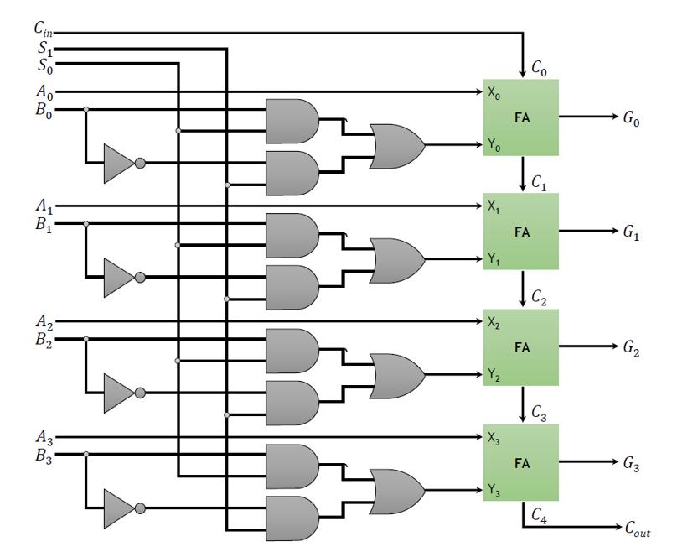
Arithmetic unit

Slide 13
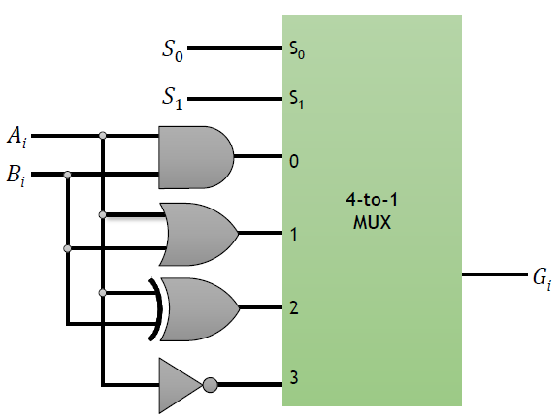

Logic unit
Performs bitwise logical operations on the bits of the operands
There are four commonly used logic operations- AND, OR, XOR, and NOT
One stage logic unit: (as many as n-bit are required)
S₁ | S₀ | Output | Operation
0 | 0 | G = A & B | AND
0 | 1 | G = A | B | OR
1 | 0 | G = A ⊕ B | XOR
1 | 1 | G = A' | NOT

Slide 14
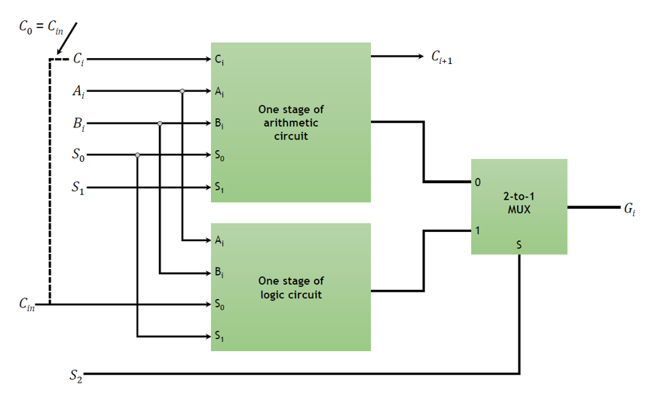
Arithmetic/Logic unit

Slide 15
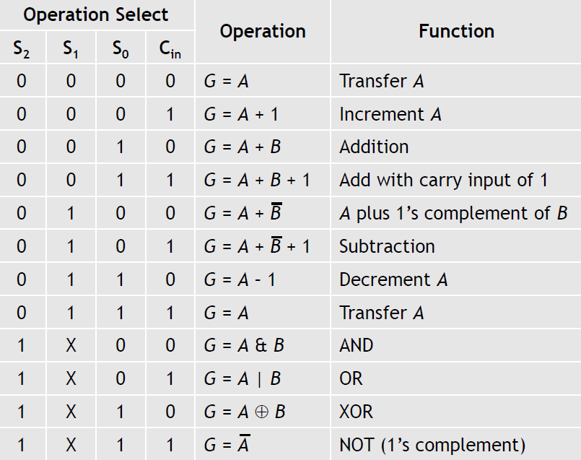
Arithmetic/ Logic unit

Slide 16
The Shifter
The shifter shifts the value on Bus B by one bit to the left or by one bit to the right
Constructed using a combinational circuit so not dependent on the system clock
The shifter can be designed using n multiplexers with two select lines:
S = 00 – no shift
S = 01 – right shift
S = 10 – left shift

Slide 17
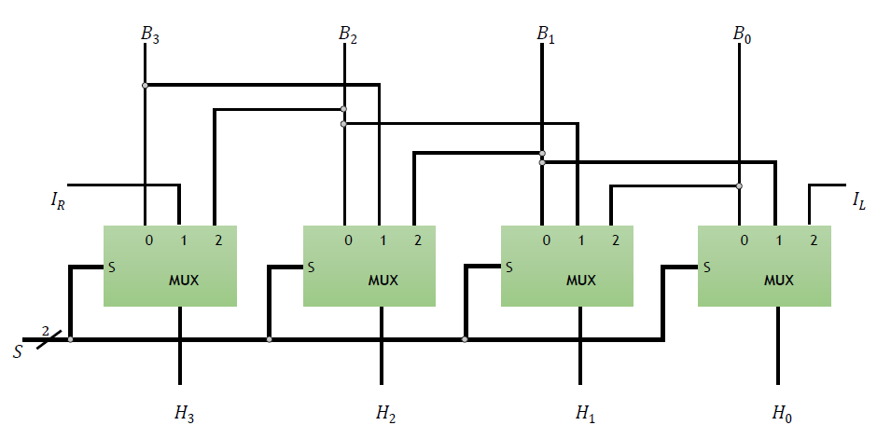
The Shifter

